Slide 1

Project Management Body of Knowledge
PMBOK
Author: Petar Jovanović 358/06
e-mail: petar.kepha@gmail.com
School of Electrical Engineering
Department for Software Engineering

Slide 2
Contents
Introduction
The Project Management Context
The Project Management Processes
The Project Management Knowledge Areas

Slide 3
Introduction
The PMBOK is an inclusive term that describes the sum of knowledge
within the profession of project management
PMBOK is applied and advanced by both practitioners and academics
PMBOK can be and is being used for projects in various fields of professions
including Software engineering

Slide 4

The Project Management Context
Project Phases and Project Life Cycle
  Each project is unique enterprise
  Phases can involve a degree of uncertainty
  Each project phase is marked by completion of one or more deliverables
  A deliverable is a tangible, verifiable work product
  The project life cycle serves to define the beginning and the end of a project
Project Stakeholders
  Are individuals and organizations who are actively involved in the project,
  Whose interests can have positive or negative influence on project execution
  and project completion.
  (Project manager, Customer, Performing organization, Sponsor)

Slide 5
The Project Management Context (I)
Organizational Influences
  Project is influenced by the
  Organizational Systems,
  Cultures,
  Style and Structure
  of Organization that set-up the project
Key General Management Skills
  Leading, Communicating, Negotiating, Problem Solving…
Socioeconomic Influences
  Standards and Regulations, Internationalization, Cultural influence

Slide 6
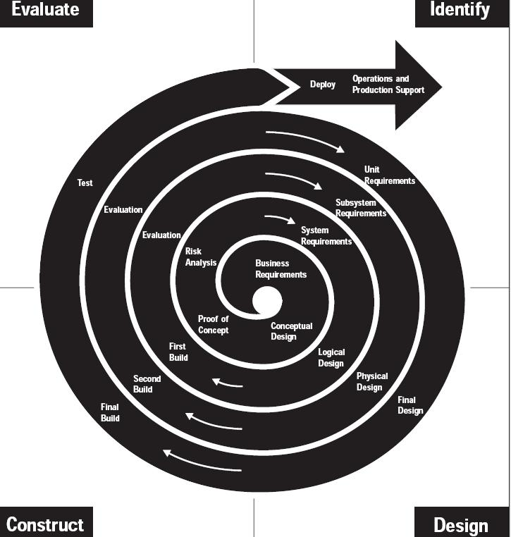
Representative Software development Life Cycle

Slide 7


The Project Management Processes
Project Management Processes
are concerned with describing and
organizing the work of the project
Product-oriented processes
are concerned with specifying and
creating the project products

Slide 8
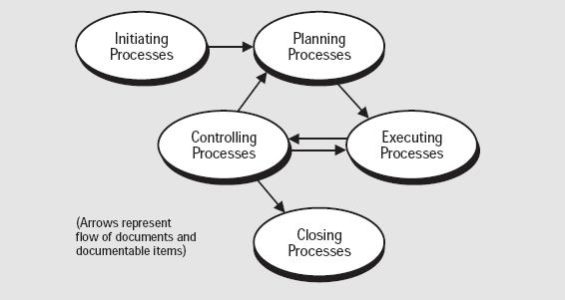
The Project Management Processes (I)
Process Groups:
  Initiating processes – recognize when project or phase should begin
  Planning processes – designing and maintaining a scheme which leads to successful accomplishment of a project
  Executing processes – coordinating people and resources to carry out the plan
  Controlling processes – monitoring and measuring progress and taking corrective actions when necessary
  Closing processes – analyzing acceptance of the project or phase and bringing it to an end
Links between process groups =>

Slide 9

The Project Management Knowledge
Areas
Project Integration Management
  Ensure that various elements of the project are properly coordinated and integrated
  Processes: Project Plan Development, Project Plan Execution, Overall Change Control
Project Scope Management
  Ensure that the project includes all the work required,
  And only work required, to complete the project successfully
  Processes: Initiation, Scope Planning, Scope Definition,
  Scope Verification, Scope Change Control
Project Time Management
  Ensure timely completion of the project
  Processes: Activity Definition, Activity Sequencing,
  Activity Duration Estimating, Schedule Development, Schedule Control

Slide 10

The Project Management Knowledge
Areas (I)
Project Cost Management
  Ensure that the project is complete within the approved budget
  Processes: Resource Planning,
  Cost Estimating, Cost Budgeting, Cost Control
Project Quality Management
  Ensure that the project will satisfy the requirements
  Processes: Quality Planning, Quality Assurance,
  Quality Control

Slide 11


The Project Management Knowledge
Areas (II)
Project Communication Management
  Ensure timely and appropriate generation, collection, storage
  And ultimate disposition of project information
    Processes:
    Communications Planning,Information Distribution,
    Performance Reporting, Administrative Closure
Project Risk Management
  Concerned with identifying, analyzing, and responding to project risk.
  Maximizing the results of positive events
  Minimizing the consequences of negative events
  Processes: Risk Identification, Risk Quantification,
  Risk Response Development, Risk Response Control

Slide 12

The Project Management Knowledge
Areas (II)
Project Procurement Management
  Acquire goods and services from outside the performing organization
  Processes: Procurement Planning, Solicitation Planning, Solicitation, Source Selection, Contract Administration, Contract Close-out
Project Human Resources Management
  Make the most effective use of people involved with the project
  Processes: Organizational Planning,
  Staff Acquisition, Team Development

Slide 13
Project Management Body of Knowledge (PMBOK) was first published by the Project Management Institute (PMI) in 1987, but was improved throughout years by Guides published in 2000, 2004.
English language 4th edition published in 2008, but translations to ten languages are expected in 2009.

Slide 14

Finally, project managers who are familiar with PMBOK can custom tailor their project management process to best fit their company's needs.
Old saying:
“To break the rules, first you have to know the rules. ”
In the long run, this means that companies will have less of a reason to outsource when projects require special treatment.

Slide 15
THE END

